Slide 1

Object Orientated Software Engineering
2.2 Finding Bugs in Software
By Stephen Lindsay

Slide 2
Outline
What is a Bug Pattern?
Introduction to bug analysis
Automated analysis
The debugger

Slide 3
Bug patterns
Bug patterns are recurring correlations between signalled errors and underlying bugs in a program.
Common pitfalls of a programming language are documented so that developers can learn to avoid them.
How to identify them
How to treat them
How to prevent them

Slide 4
Bug pattern: Predictable random number generation
Vulnerable Code:
String generateSecretToken() {
Random r = new Random();
return Long.toHexString(r.nextLong());
}
Notes:
Why is predictable random number generation bad?

Slide 5
Fixing bad random
Solution:
import org.apache.commons.codec.binary.Hex;
String generateSecretToken() {
SecureRandom secRandom = new SecureRandom();
byte[] result = new byte[32];
secRandom.nextBytes(result);
return Hex.encodeHexString(result);
}
Replace with something stronger
Notes:
Why is predictable random number generation bad?

Slide 6
Bug patterns: Object Deserilaiazation
Serialization and deserialization are the process of turning objects into byte streams and back again
Used for storage in file systems and network transmission
Deserialization is a sensible operation but it has an extensive history of vulnerabilities.
Object deserialization of untrusted data can lead to remote code execution.
This is a very significant security risk! An easy way for someone to take over your system

Slide 7
Bug patterns: Object Deserilaiazation
The method below returns an instance of the class User Data created with information from an Input Stream:
public UserData deserializeObject(InputStream receivedFile) throws IOException, ClassNotFoundException {
try (ObjectInputStream in = new ObjectInputStream(receivedFile)) {
return (UserData) in.readObject();
}
}

Slide 8
Fixing Object Deserilaiazation
Never deserialise input from a remote user if it can be avoided.
When it can not be avoided, you have to program checks on the domain input robustly with sanitisation.

Slide 9
Bug patterns: Trust Boundary Violations
Trust Boundaries are metaphorical lines we draw through a program.
On one side of the line, data is assumed to be trustworthy, on the other side the data is untrusted
(In my experience, this is sometimes an implicit line – you work to it without ever realising you have made the assumption!)
Validation logic allows data to move from the untrusted side of the boundary to the trusted side – to become trusted data
Trust boundary violations occur when a program blurs the line between trusted and untrusted data

Slide 10
Bug patterns: Trust Boundary Violations
The following code accepts an HTTP request and stores the username parameter in the HTTP session object before checking to ensure that the user has been authenticated.
usrname = request.getParameter("usrname");
if (session.getAttribute(ATTR_USR) == null) {
session.setAttribute(ATTR_USR, usrname);
}
Solution:
Add validation prior setting a new session attribute. When possible, prefer data from safe location rather than using direct user input.

Slide 11
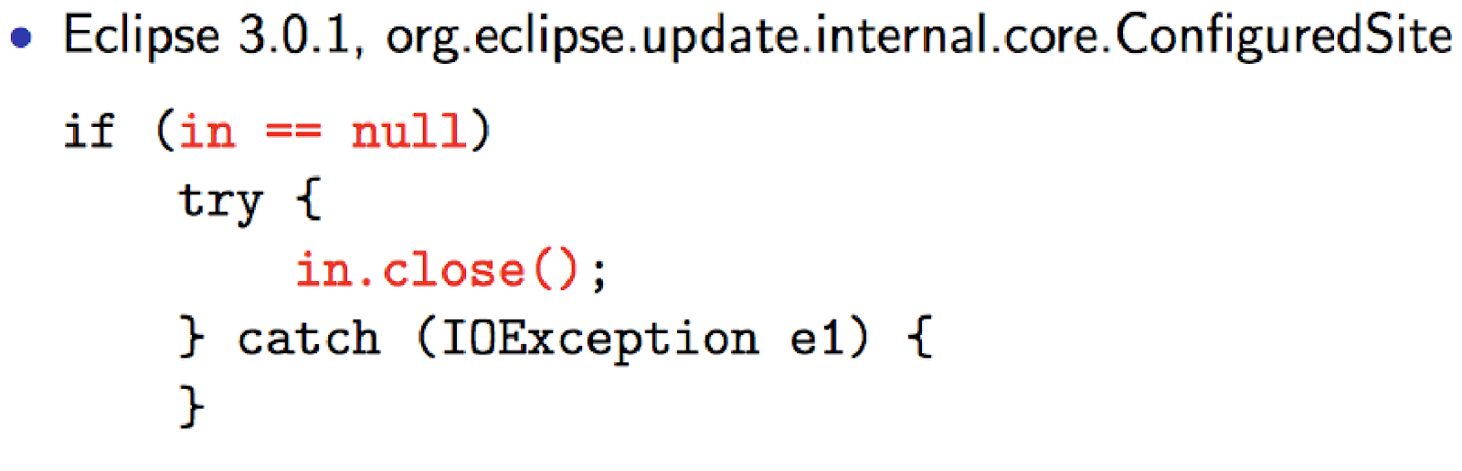
Bug patterns: Null pointer exceptions
Notes:
A couple of old friends from last week with new names now….

Slide 12
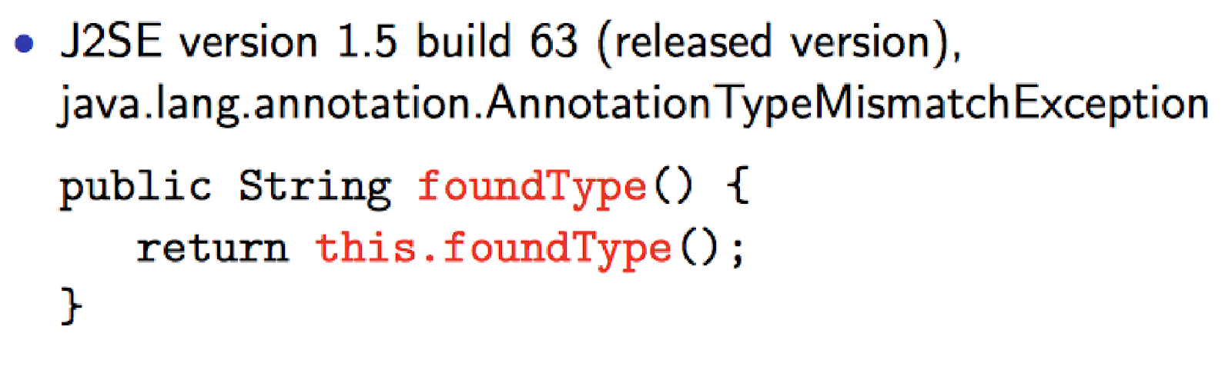
Bugs patterns: Infinite recurssion

Slide 13
Bug pattern categories
Correctness of the program
Infinite loops, reading unwritten fields
Not conforming to best practice (a bad practice)
Failing to close file readers
Internationalization problems
Not adapting to other languages or locales
Malicious code vulnerability
Unsafe Deserialization
Multithreaded correctness
Access flags and concurrency
Performance
Slow code
Security
Bad random number generation
Dodgy code
Unused variables, unchecked casts
Notes:
Java, in particular, gets a lot of hate online for it’s security

Slide 14
Bug patterns Takeaways
Not all bugs are subtle and unique
In fact, they are prevalent enough we can come up with names and categories of bug pattern broken down by programming language
Many bugs share common characteristics
A bug pattern is a code idiom that is usually a bug
Detection of many bug patterns can be automated using simple analysis techniques

Slide 15
Debugging
Debugging is the process of using the symptoms of a bug to find and fix it’s underlying cause in code, design or specification. Covered in these lectures are
Automated/static analysis tools – to catch potential problems with the code without coder time as an input
Debugging tools – most IDEs have a debugger to help you
There are other ways to debug code as well
Threat modelling – look at the design of our code, write out or make diagrams showing where things might go wrong
Code review – having an external party look over the code to gauge it’s quality/readability
A very important technique (At the core or businesses like Google)

Slide 16
Code Inspection
Manually examine source code to look for bugs
Limitations to the approach though:
Labor intensive
Subjective: Source code might appear to be correct when it is is not.
Can you spot the typo in this slide?
People have similar blind spots reading source code

Slide 17
Static Analysis Theory
Use a program to analyse your program for bugs
Analyse statements, control flow, method calls, etc
Some theoretical advantages :
Can analyse many potential program behaviours
Doesn't get bored
Relatively objective
However, static analysis is not without limitations, most famous of these being The Halting Problem
We can never say in advance if a program will terminate
So when we ask “Does program P have bug X?” or “Can program P reach state X?” we can not know for certain, instead we rely on approximations of the program to make estimates

Slide 18
Static Analysis Trade-offs
Soundness - Whenever there is a bug in the program an alert is raised
Unsound means the system can generate false negative outputs
Missing a bug that is present in the code being analysed
Precision - every bug alert in the program is actually a bug
Imprecision means the bug detection system can generate false positive outputs
Attributing a bug to a piece of code that does not cause a bug

Slide 19
Static Analysis Trade Offs
The detection of bugs in a program is an approximation that involves trade-off between soundness, precision and execution time
Can a bug detection system be designed such that it always overestimates possible program behaviours
Never misses a bug, but might report some false warnings (Sound but imprecise)
Problem: The analysis may report so many false warnings that the real bugs cannot be found!

Slide 20
Static Analysis Trade Offs
Can a bug detection system be designed such that it always underestimates possible program behaviours?
Never reports a false warning, but might miss some real bugs (Precise but unsound)
Problem: The analysis may not find all the critical bugs!
Balanced approximation - A static analysis to find bugs does not need to be consistent in its approximations
Neither sound nor complete: miss some real bugs and report some false warnings but still see use!

Slide 21
Static Analysis and Compilers
Modern IDEs incorporate a lot of static analysis tools into their compilers to spot a range of problems
Simple security errors through to more complex issues are caught by these tools
See what Eclipse does to analyse your code – type “Java Compile Errors/Warnings Preferences” into Help > Search to see the full list

Slide 22
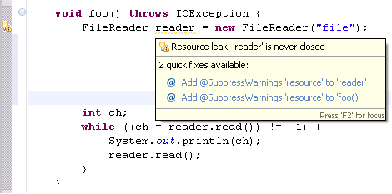

Slide 23
Debuggers
Your examination of code is also supported by debugging tools
Debuggers typically allow step-by-step execution of your code, 1 line at a time to see what is happening
Saves you writing: System.out.printLn(“Here”);
Considerably more powerful than that – step-by-step execution of code and full inspection of all variables possible with the debugger

Slide 24
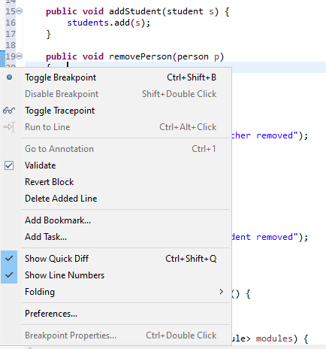
Breakpoints
Set a breakpoint in eclipse by right clicking and choosing Toggle Breakpoint on a specific line of code
Execution of the code will now pause when it comes to that line
You should be asked to switch to the debug viewer

Slide 25
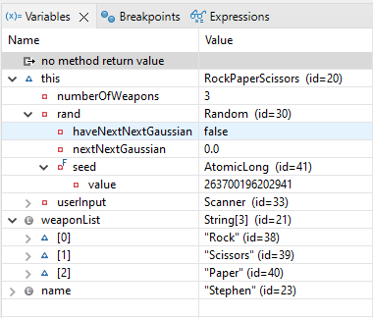
Inspecting variables in debug
The debug view shows you the status of the different variables that are currently declared
This allows you to check the expected state of the program against the actual state
Source code is still open and hovering your cursor over a variable will also show you it’s current status
Right clicking on a variable lets you change it in this tab!

Slide 26
Resume, Stepping in, and Over
The debugger lets you decide if you want to:
Resume operation – run until the next breakpoint or until the program terminates
Pause (if the code is currently executing –useful if code hangs or in real time apps)
Terminate thee program
Step in – execute the next line of code
Step over – move past a line of code

Slide 27
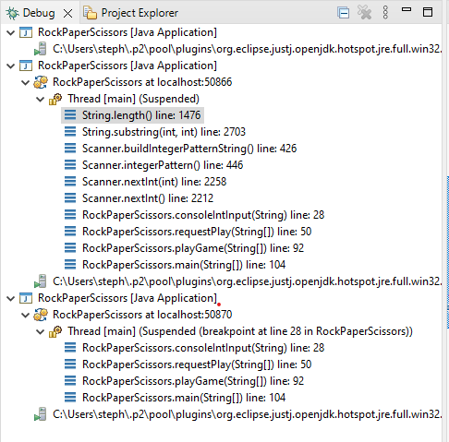
Debug window
The debug window shows where you are in the execution of your program
Particularly useful when you are stepping into execution and find yourself deep in the underlying libraries

Slide 28
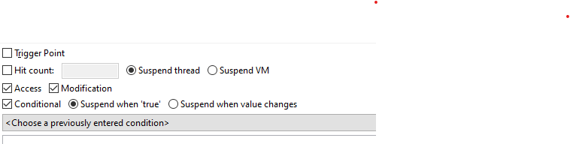
Watchpoints
Double right-clicking on the line a variable is declared on will set a watchpoint on that variable
You can choose if this will pause execution when the variable is changed or when it is accessed
Useful for pinpointing errors when you know that some piece of code is causing a mistake by altering a variable but don’t know which
Especially exciting conditionals can be used to, for example, pause when a pointer moves past a known boundary!

Slide 29

Exceptions and Stack Traces
When your code throws an unhandled exception you get a stack trace in the console window
The various methods active at the time are shown
Clicking on the highlighted parts will take you to the lines of code being executed
In general, you want to look for your code and not underlying libraries to interpret these

Slide 30
Outline
What is a Bug Pattern? Common mistakes in code that appear often enough to have their own names and categories
Introduction to bug analysis – Range of techniques out there, we focus on individual ones
Automated/Static analysis – Looking for approximate errors in code, a part of compilers in the modern era
The debugger – Powerful tool with a wide range of abilities, including step-by-step execution, variable watching and modification and exception tracing - your best friend debugging your own code!

